Slide 1
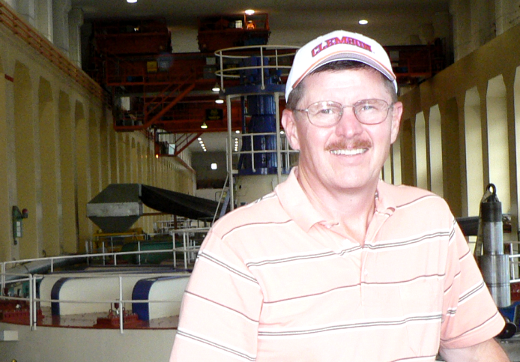

Research Directions
Richard T. Christoph, PhD
Professor of Business and Information Systems
Rick.Christoph@dsu.edu
http://www.homepages.dsu.edu/christor/
Touring Bonneville Dam on the Columbia River, Oregon.

Slide 2
My Background
Earned my Doctor of Philosophy degree in Industrial Management (minor in Economics) from Clemson University, Clemson, South Carolina, in August, 1985
  Dissertation in Corporate Strategic Divestiture
Joined Dakota State University in 1998 as Dean of the College of Business and Information Systems;
  Now serve as Professor of Business and Information Systems.

Slide 3
Background, Con’t
Inaugural faculty member for Florida Gulf Coast University in Ft. Myers, Florida as the university was designed, built and opened in 1997 as the 10th State of Florida institution.
Worked at James Madison University in Virginia for 11 years as a faculty member and administrator.
Worked as a Marketing Representative with the IBM Corporation specializing in large scale, online computing systems.

Slide 4
Research Interests & Directions
I have enjoyed many different areas of research over the years.
I am the author of over 40 books, journal articles and proceedings in the Management and Computer Information systems area
I have particularly enjoyed working with survey-based research.

Slide 5
Current Research
I am now involved in an ongoing research stream designed to evaluate the instructional effectiveness of computer-based mobile computing systems and the impact of such systems on faculty and student productivity.

Slide 6
Last Year’s Publications
Working with Professors Puetz, Walters, and Moran:
“Computer Self-Efficacy As An Indicator of Tablet PC Effectiveness In The Classroom”, presented and published in the refereed Proceedings for the 2007 Academy of Management meeting.
“A Longitudinal Study Using Self-Efficacy Precepts To Evaluate Instructional Effectiveness Of Tablet PC Systems In The Classroom” presented and published in the refereed Proceedings for the 2007 South Western Decision Sciences meeting.
“Does Familiarity Breed Contempt? Comparing Instructional Effectiveness of Tablet PC Systems between Freshman and Upper Class Business Majors” presented and published in the refereed Proceedings of the 2007 South West Academy of Management meeting.
“The Distraction Factor – Does The Use Of Student Computers In The Classroom Lead To Educational Distraction?” presented and published in the refereed Proceedings of the 2007 Western Decision Sciences meeting.

Slide 7
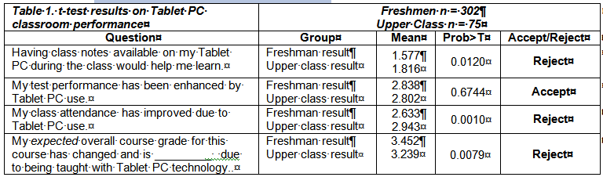
A Sample of the Research
Hypothesis 1: There will be no difference between new freshman computer users and more experienced upper class students in student self assessment of the Tablet PC as a tool to enhance classroom performance.

Slide 8
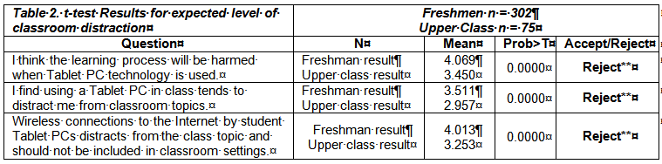
A Sample of the Research
Hypothesis 2: There will be no difference between freshman and upper class business majors in the expected level of in class distraction caused by Tablet PC systems between students based on the student’s self-assessment of their level of Tablet PC expertise.

Slide 9
The Bottom Line
Results from “Computer Self-Efficacy As An Indicator of Tablet PC Effectiveness In The Classroom”:
  This recent project focused specifically on classroom performance and distraction and shows that initial student expectations are not matched by upper class student experiences with regard to several measures of Tablet PC instructional effectiveness.

